Slide 1
YOUTUBE STREAMER ANALYSIS
PRESENTED BY : KAYODE OLUWATOBI
DATE : MARCH 2024.

Slide 2
OBJECTIVES
Identify trends among Youtube streamers. What are the most popular categories?
Check for correlation between the number of Subscribers, likes or comments.
Are there patterns in these metrics(Subscribers, likes, comments and visits)?
Which categories have the highest number of streamers? Are there specific categories with exceptional performance metrics?
Who are the top performing content creators?
Propose a system for enhancing content recommendations to YouTube users based on streamers' categories and performance metrics.

Slide 3
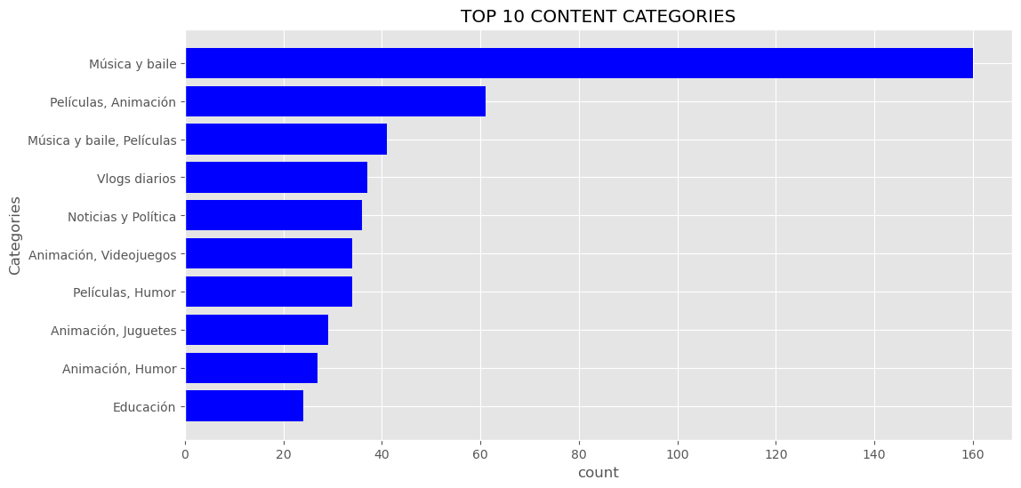
THE MOST POPULAR CONTENT CATEGORIES
These are the top 10 categories when it comes to popularity among top streamers all around the world.
The most popular category is the "MUSICA Y BAILE" with a count of 160 .

Slide 4
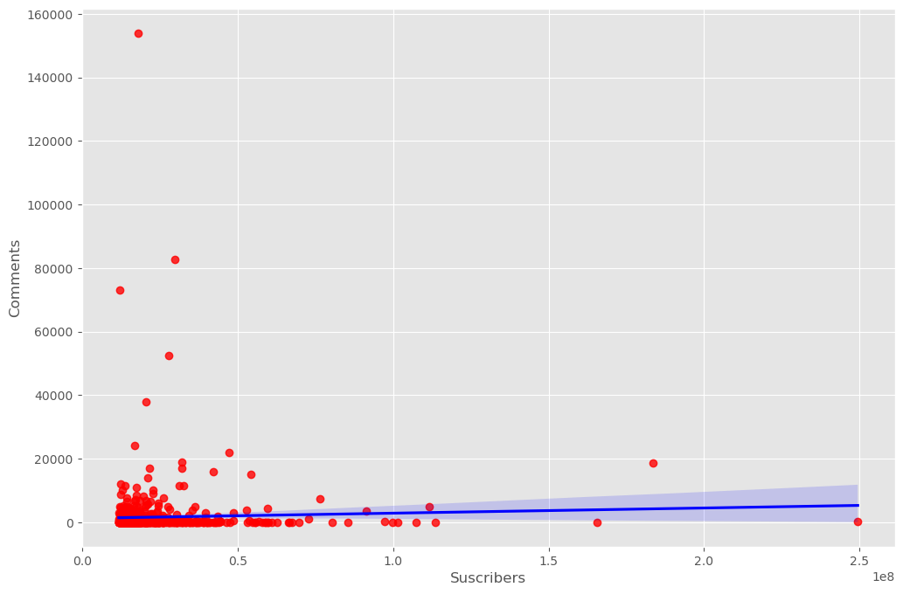
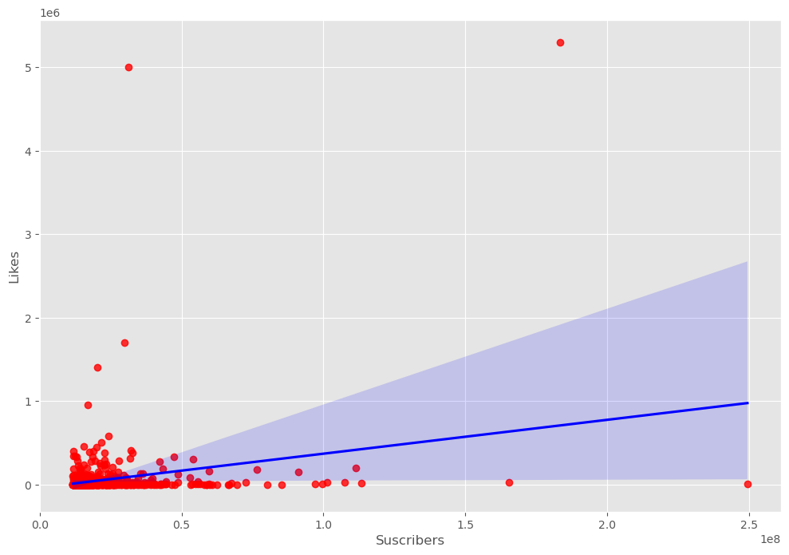
Correlation between the number of subscribers, likes and comments.
Correlation shows the relationship between two or more variables.
Correlation values ranges from 0 to 1. 0-0.19 is regarded as very weak, 0.2-0.39 as weak, 0.40-0.59 as moderate, 0.6-0.79 as strong and 0.8-1 as very strong correlation.
The correlation coefficient between the number of subscribers and comments is "0.037" which shows very weak correlation. It means the number of subscribers behaves differently from the number of Comments.
The correlation coefficient between the number of subscribers and likes is "0.25" which signifies weak correlation. It simply means the number of subscribers behaves differently from the number of likes, that is, a streamer's subscribers might be the highest but has the lowest likes.

Slide 5
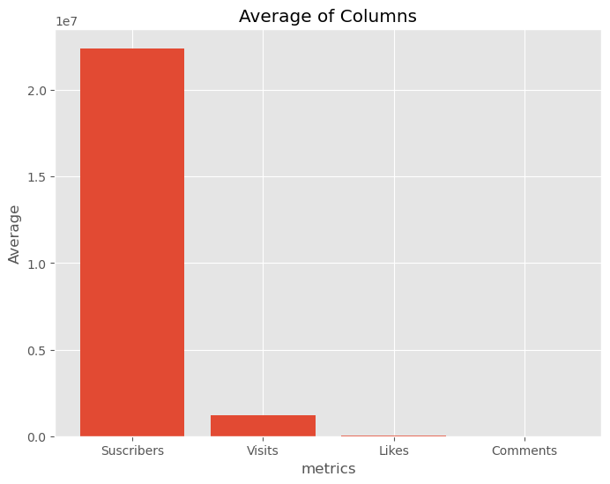
Patterns in these metrics(Subscribers, likes, comments and visits).
There are no patterns or anomalies in these metrics.

Slide 6
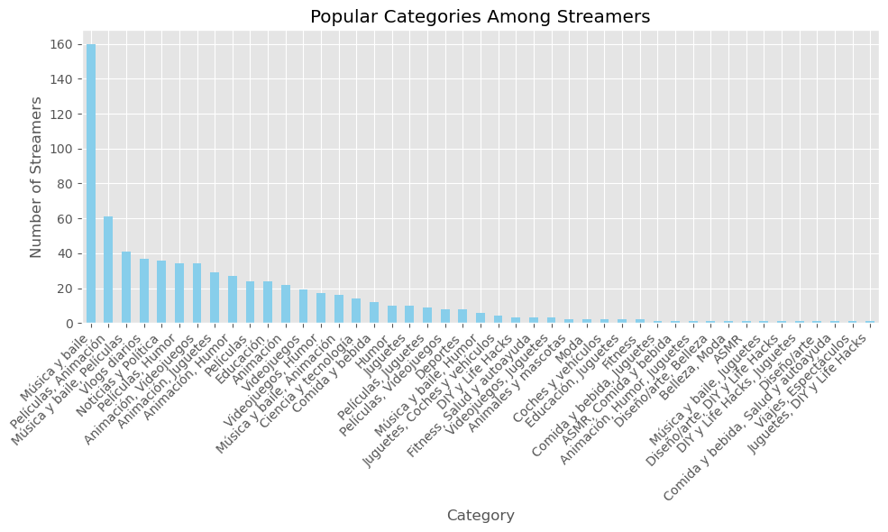
Content Categories with the highest number of streamers.
The chart shows every categories given in the dataset and the number of streamers associated with each of the categories.
The most popular category amongst the streamers is the "MUSICA Y BAILE".
The least of the categories is the "JUGUETES DIY Y LIFE HACKS".

Slide 7
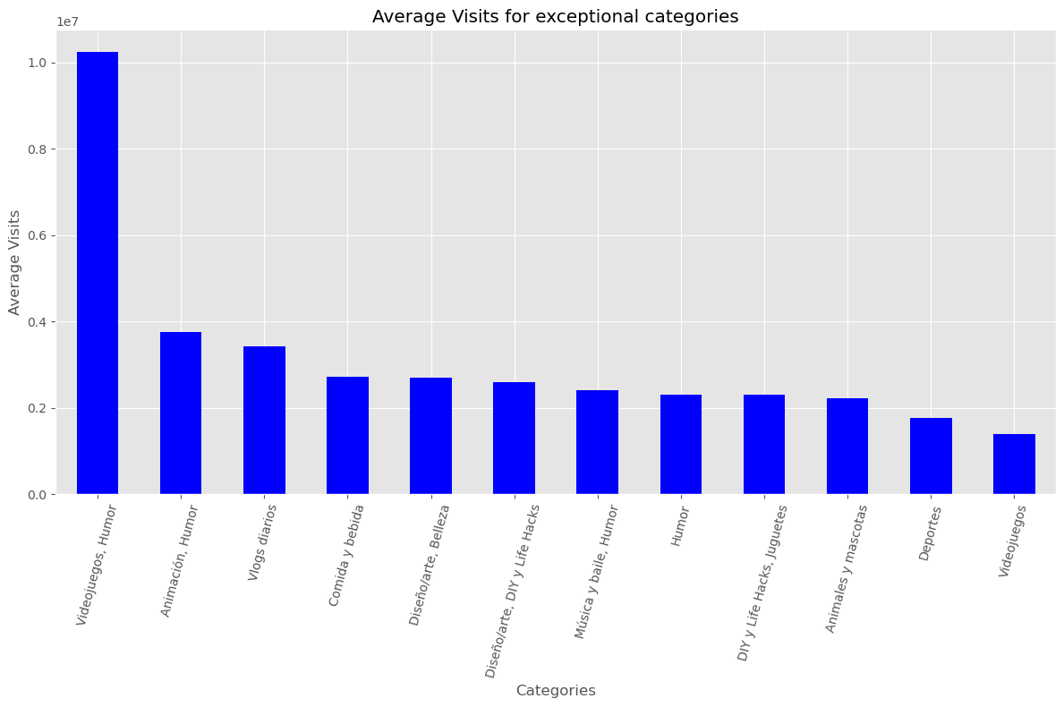
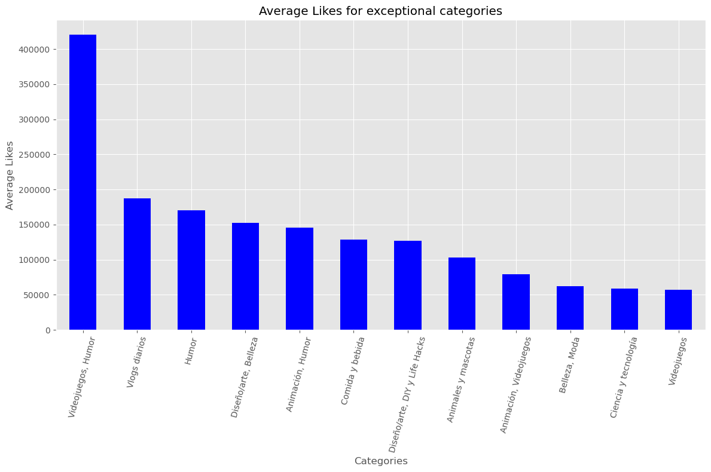
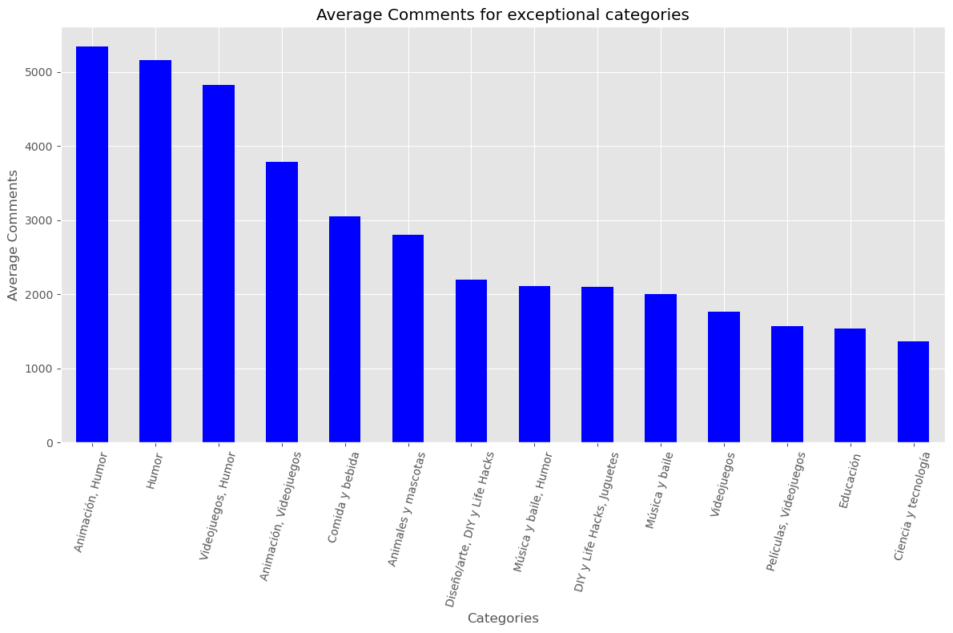
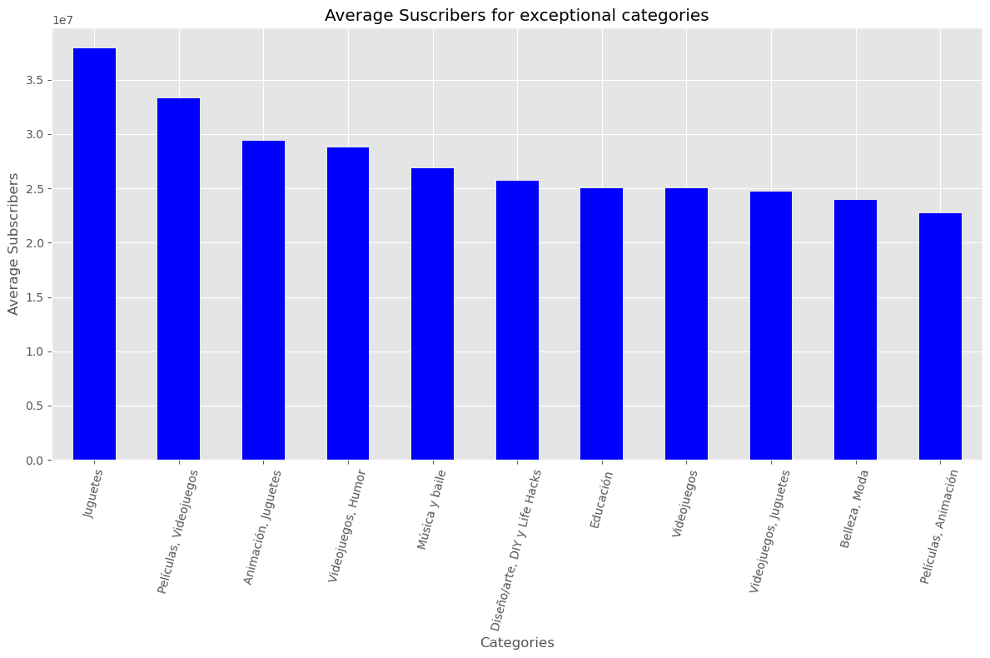
Categories with exceptional performance metrics
The performance metrics includes the Subscribers, Comments, Likes and Visits for each categories.
We defined a category as being exceptional by checking if the category belongs to the list of categories that has their values for each of the metrics greater than the average of each of the metrics as shown in the charts.
There are three categories that belongs to this group and they are "VIDEOJUEGOS,HUMOR", "DISENLARTE DIY LIFE HACKS", and "VIDEOJUEGOS".

Slide 8
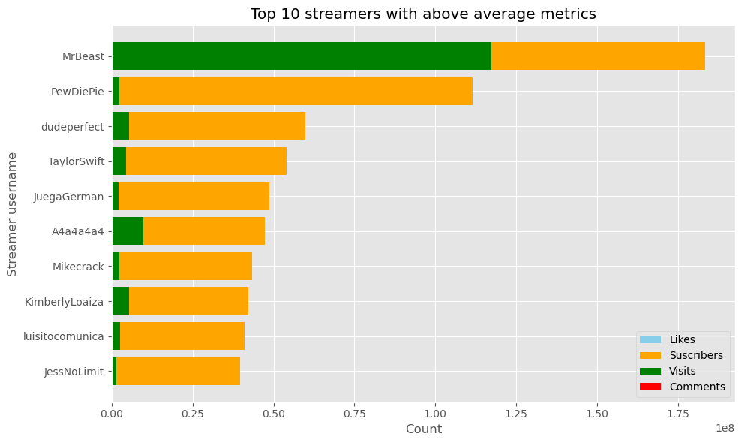
TOP PERFORMING CONTENT CREATORS
The top 10 performing creators with performances above the average of each metrics being compared to are shown in the charts.
These content creators are good candidates for brands collaboration and marketing campaigns due to the number of subscribers they have and the visits they get on their streams and pages.

Slide 9
Propose a system for enhancing content recommendations to YouTube users based on streamers' categories and performance metrics.
Use content-based filtering techniques to recommend content based on the features and attributes of the content itself.
Analyze the metadata of videos (e.g., titles, descriptions, tags) and streamers (e.g., categories, performance metrics) to identify similarities and relevance.
Recommend content to users based on their preferences and the content's relevance to their interests and past interactions.
Recommend content to users based on what similar users have liked or interacted with in the past.
Consider factors such as user demographics, viewing history, watch patterns, time of day, device used, and geographical location to tailor recommendations.
Provide contextual recommendations by considering trending topics, events, seasons, or user interests at specific times.
Collect user feedback through surveys, ratings, and explicit feedback mechanisms to understand user satisfaction and improve recommendation quality.

